Slide 1
August 19 Video Update: Fall 2021 Stepwise Plan
Unitarian Church of Lincoln
Rev. Oscar Sinclair

Slide 2
Current Situation
Lancaster County COVID-19 cases/100K
Colors correspond to Harvard GHI thresholds
https://public.tableau.com/app/profile/healthynebraska/viz/NebraskaCountyCOVID-19Ratesper100K-HarvardGHIThresholds/CountyRates

Slide 3
Assumptions
The “Second Marathon.” Period of uncertainty with Delta variant, rapidly changing case and vaccination rates.
While masks and vaccination significantly decrease risk, evidence suggests breakthrough cases, transmission from vaccinated to unvaccinated is possible.
No children under 12 vaccinated yet, likely still several months away.
Varying levels of risk tolerance/aversion among the congregation.
We have done this before.

Slide 4
Lancaster County COVID-19 Risk Dial
Green | Low risk of COVID-19 spread, low impact on community.
Yellow | Moderate risk of COVID-19 spread, moderate impact on community.
Orange | High risk of COVID-19 spread, high impact on community.
Red | Severe risk of COVID-19 spread, Severe impact on community.

Slide 5
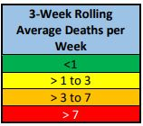
Lancaster County COVID-19 Risk Dial Metrics
Test Positivity Rate (average weekly percent positivity)
Case Rate (number of new cases/100,000 people)
Testing Turnaround Time (average time from sample collection to report)
Contact Tracing (percent of cases & contacts contacted within 48 hrs)
Health Care System Impact and Capacity (percent of ICU beds available & percent of Medical/Surgical beds used to care for COVID-19 patients)
Vaccination (percent of eligible population vaccinated)
Deaths (3 week rolling average of deaths/week)
https://app.lincoln.ne.gov/city/covid19/pdf/COVID19RiskDialMetricsDescription.pdf

Slide 6
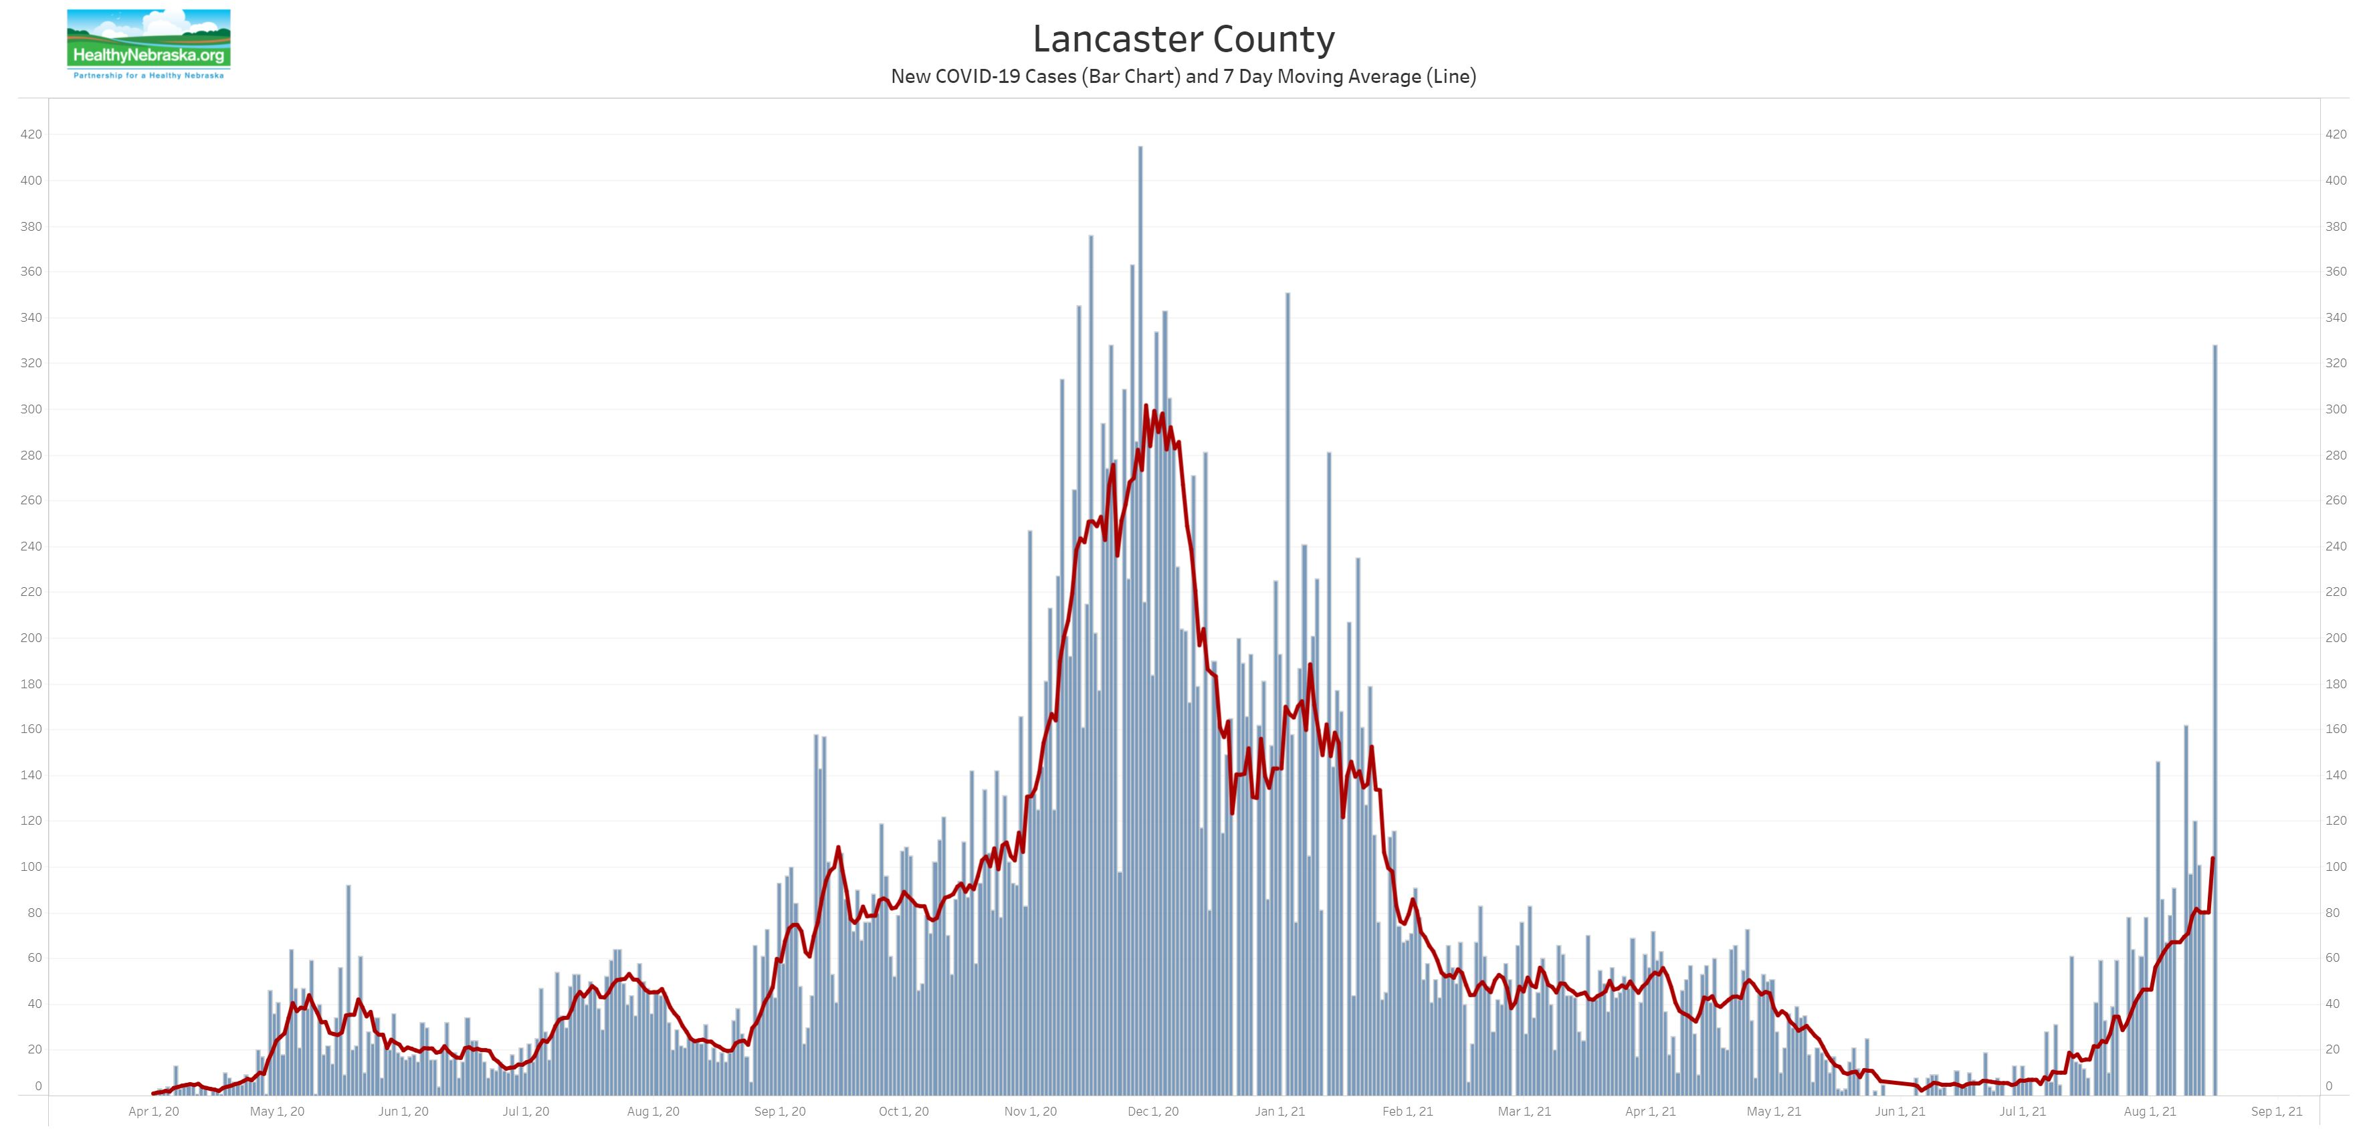
Lancaster County COVID-19 Risk Dial
Green | Low (Summer 2021, pre-Delta)
Yellow | Moderate (Spring 2021, post-vaccine)
Orange | High (Fall 2020)
Red | Severe (Winter 2020-21)

Slide 7
Proposed Stepwise Plan for Fall 2021
Unitarian Church of Lincoln

Slide 8
UCL Programming Overview
Single service on Sunday morning, 10:00 AM. If risk dial is in green or yellow on LLCHD risk dial, both in person and livestreamed. If risk dial is in orange or red, livestreamed or prerecorded.
Vespers services on Third Thursday of the month, in person at green or yellow, online at orange and red.
Office is open at green and yellow, becomes primarily remote at orange and red.
Sunday school transitions to online at mid-yellow, reflecting lack of pediatric vaccine.
Rentals, rites of passage, and other events follow similar guidelines.

Slide 9
Green – “Status Quo”
Worship Capacity | 10:00, Full Capacity and Livestreamed. Masks required while indoors on Sunday morning until pediatric vaccines are available.
Small Groups | Small Groups can meet without advance notice.
RGL | In person, age-based programming following Time for All Ages
Office | Posted office hours.

Slide 10
Yellow – Increasing Measures
 | LOW | MID | HIGH
Worship/Capacity | 75 ppl in Sanctuary Masks required | 50 | 37
Small Groups | Yes, with masks. Or masked outdoors | <15, with masks and social distance Or masked outdoors | <15, with masks and social distance Or masked outdoors
RGL | Multi-Platform | Online | Online
Office | Open, with masks | By appointment | By appointment

Slide 11
Orange – Primarily Online
Worship Capacity | Sunday morning worship continues with participants (<10) present and masked livestreaming at 10:00 Sunday morning.
Small Groups | Small groups meet online.
RGL | Online at 11:00 Sunday
Office | Staff primarily works from home. Office open by appointment, but staff and congregation are encouraged to interact online.

Slide 12
Red – Building Fully Closed
Worship Capacity | Worship prerecorded from home, edited together remotely
Small Groups | Building closed, all meetings on Zoom
RGL | Online at 11:00 Sunday
Office | Building closed, all meetings online

Slide 13
Stepwise Plan – short short version
Green (low): Status quo, church basically open
Yellow (moderate): Varying mitigation measures for in person activities
Orange (high): UCL is primarily online for programming
Red (severe): All UCL operations are fully remote

Slide 14
Howard Zinn You Can’t Be Neutral on a Moving Train (2002)
To be hopeful in bad times is not just foolishly romantic. It is based on the fact that human history is a history not only of cruelty, but also of compassion, sacrifice, courage, kindness.
What we choose to emphasize in this complex history will determine our lives. If we see only the worst, it destroys our capacity to do something. If we remember those times and places—and there are so many—where people have behaved magnificently, this gives us the energy to act, and at least the possibility of sending this spinning top of a world in a different direction.
And if we do act, in however small a way, we don’t have to wait for some grand utopian future. The future is an infinite succession of presents, and to live now as we think human beings should live, in defiance of all that is bad around us, is itself a marvelous victory.

